Slide 1


Design Dexterity Challenge
Author: ZEENATH KOUSAR SHAIK

Slide 2

CONTENTS
1. Problem Understanding
2. Problem-Solving Approach
3. Data Structures Used
4. State Transition Logic
5. Algorithm Efficiency
6. Output & Sample
7. Features
8. Final Summary

Slide 3


Problem Understanding
1
Objective
• Design and implement an algorithm to solve a 3x3 Rubik’s Cube from any scrambled state.
2
Key Points
• Mimic real-world solving logic through programmed moves.
• Efficient state tracking and manipulation.
• Ensure move correctness and reach goal state.

Slide 4


Problem-Solving Approach
Breakdown Strategy
Phases
• Model the cube as a 6-faced matrix (each face = 3x3 grid).
• White Cross →
• White Corners →
• Each move affects one face + adjacent side rows/columns.
• Middle Layer →
• Yellow Cross →
• Solve using Beginner's Layer-by-Layer method or search algorithm (BFS or IDDFS).
• Yellow Corners →
• Final Alignment

Slide 5

Data Structures Used
1
Cube Representation
• 6 Lists/Arrays (U, D, F, B, L, R)
• Each list has 9 values ('W', 'R', 'B', 'G', 'O', 'Y')
2
Move Logic
• Dictionary of transformation mappings for each move
• Track cube state as a tuple for hashing (used in BFS)

Slide 6


State Transition Logic
Move Simulation
Prediction & Tracking
• Each move rotates a face and updates 3 adjacent edges.
• Store visited states in BFS to avoid infinite loops
• Compare with solved state using equality check
• Implemented as a set of index swaps.

Slide 7

Algorithm Efficiency
Approach
• BFS (Breadth First Search)
• Ensures shortest path to solution
• Might use memory quickly
• Time Complexity: O(b^d), where b is branching factor, d is depth
• Space: Depends on visited states
• Optimizations: IDA*, Thistlethwaite’s Algorithm (optional extension)
Github : https://github.com/shaik-zeenath-kousar/rubiks-cube-solver

Slide 8



Example
Scrambled Input
Output Moves
Final Output
Random face values
["F", "R", "U", "R'", "U'", "F'"]
Solved cube representation

Slide 9

Add-ons
1
Visualizer with pygame (2D simulation)
2
Web simulation with Three.js or p5.js
3
Extended to 2x2, 4x4 cubes
4
Colorful terminal output with step-wise display

Slide 10
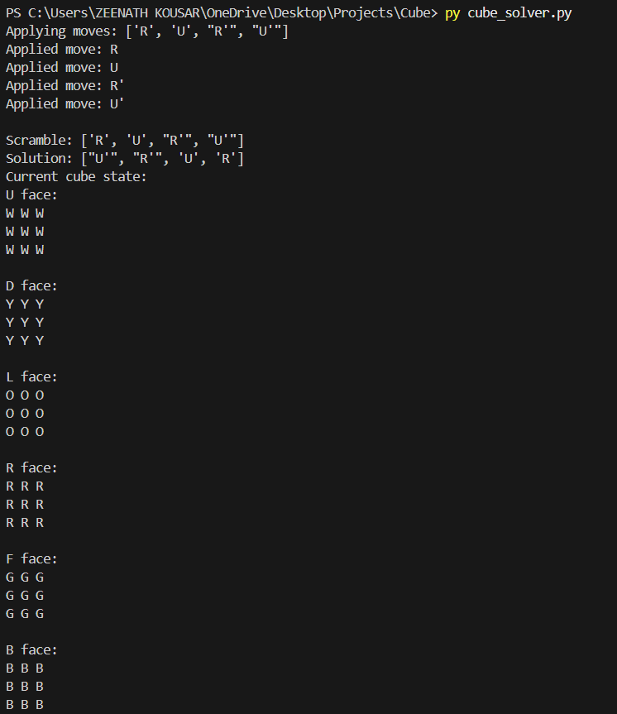
Output

Slide 11




Final Summary
✔ Built a working algorithm for solving 3x3 Rubik’s Cube
✔ Clean modeling, efficient state tracking
✔ Optional UI or scalability possible
✔ Fulfills all deliverables

Slide 12

Thank You
ZEENATH KOUSAR SHAIK
[skzeenathkousar@gmail.com]
[https://github.com/shaik-zeenath-kousar/rubiks-cube-solver]
[www.linkedin.com/in/zeenath-kousar-shaik]

